Slide 1
Shopping
Prof. Ioana Dumitrescu
Liceul Teologic Adventist Stefan Demetrescu, Bucuresti

Slide 2
Aims
At the end of the lesson the students will be able to:
Build up “shopping collocations”
Use the collocations in dialogues

Slide 3

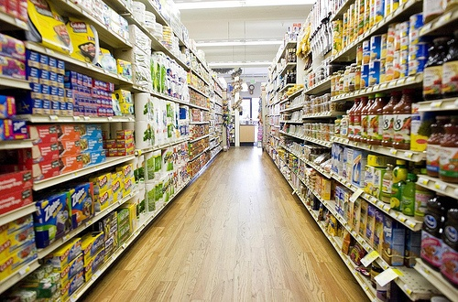
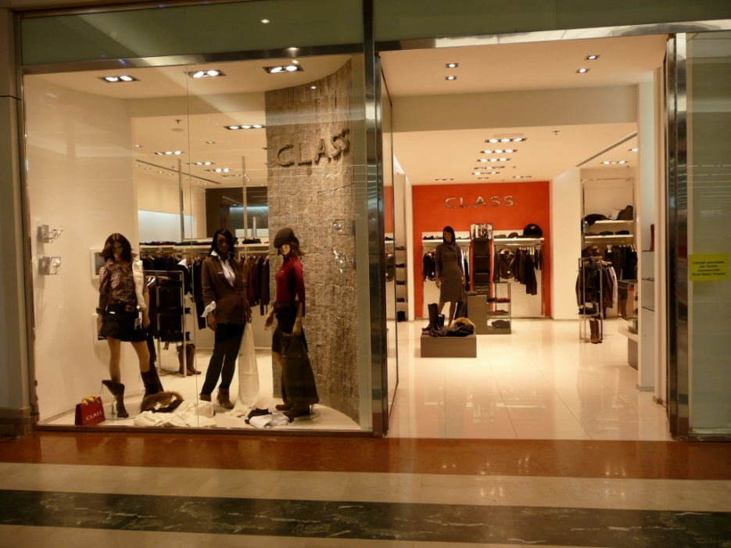

A MARKET
A SUPERMARKET
A SHOP
ONLINE

Slide 4
LESSON PLAN
TIME: 50 MINUTES
NUMBER OF STUDENTS: 32
GRADE: IXth
TEXTBOOK: Just Right intermediate by Jeremy Harmer, Marshal Cavendish Ltd 2004
CLASS LEVEL: INTERMEDIATE
TOPIC: SHOPPING
SKILLS: speaking, writing, listening
LANGUAGE FOCUS: Collocations
AIMS: by the end of the lesson the students will be able to:
Recognize and build up “shopping collocations”
Use the collocations in dialogues
Improve listening skills
AIDS: handouts, chalk, blackboard, images, tracks

Slide 5
WARMING-UP: T greets the students and asks them how are they feeling, asks about the absentees
TIME: 2 min
HOMEWORK CHECK: T asks the students to read their homework and has them correct the mistakes they notice.
TIME: 5 min
ACTIVITY 1:
AIMS: to introduce the students into the new topic, introduce the new structures
TIME: 10 min
INTERACTION: T-S
PROCEDURES: Teacher begins the activity by asking the students what do they usually shop for and then shows them 4 pictures and asks them which of the following places to shop is best, which is worst and why.
Then the teacher shows a flipchart where there are some words that can be combined with the word “Shopping” to form collocations. Ss build up collocations and write them on the board, in a chart.
ACTIVITY 2:
AIMS: to use the collocations in dialogues
TIME: 13 min
INTERACTION: T-S/S-S
PROCEDURES: Ss receive handouts where they complete some short dialogues with the collocations they have built. Ss work in pairs. Ss check their answers by listening to a track. The T elicits the right answers from the students.

Slide 6
ACTIVITY 3:
AIMS: to improve listening skills
TIME: 15 min
PROCEDURES: Ss receive handouts with short dialogues in a shop. They fill in the missing lines and check their answers by listening to a track. Ss work in pairs. The T elicits the right answers from the students.
ACTIVITY 4: EVALUATION
TIME: 5 min
The teacher evaluates along with the students if the aims have been fulfilled
HOMEWORK: “Imagine you are in a mall and you are looking for some clothes. Build up a 10 lines dialogue between you and the shop assistant. “

Slide 7
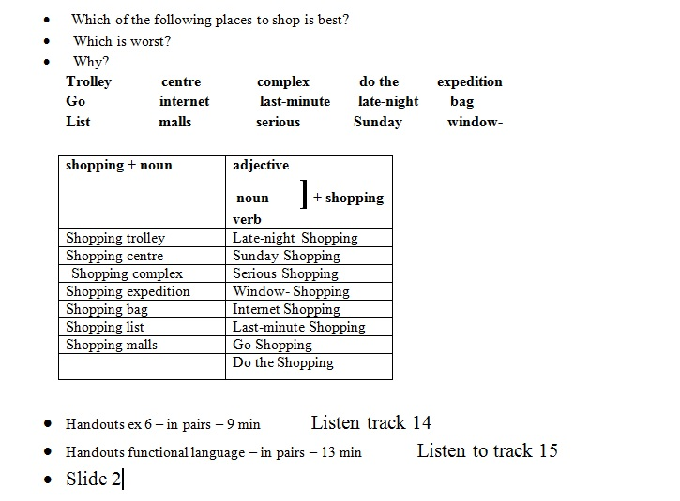
Notes:
Teacher’s notes

